Slide 1
IBM PROJECT-21 External Mentor : Parash Kothari Aditya Maheswari Internal Mentor : Nilakshi Gogoi Submitted By: 1. Ruhi Anwar Zaman 2. Sankalpa Jyoti Bora 3. Gunjan Deka 4. Ankit Borgohain

Slide 2
Project Defination- Programing Language Classification with IBM Watson Studio, Watson, And GitHub.

Slide 3
Contents 1. prerequisites 2. project understanding 3. flow chart 4. creation of project 5. result 6. future scope 7. conclusion

Slide 4
PREREQUISITEs: 1. IBM Cloud Account 2. Watson Studio 3. Watson Natural Language Classifier 4. Jupyter Notebook

Slide 5
PROJECT UNDERSTANDING
In this Code Pattern, we will use Jupyter Notebooks in IBM Watson Studio to build a model that predicts a code's programming language based on its text.
The model will then be evaluated using IBM's Watson Natural Language classifier.

Slide 6
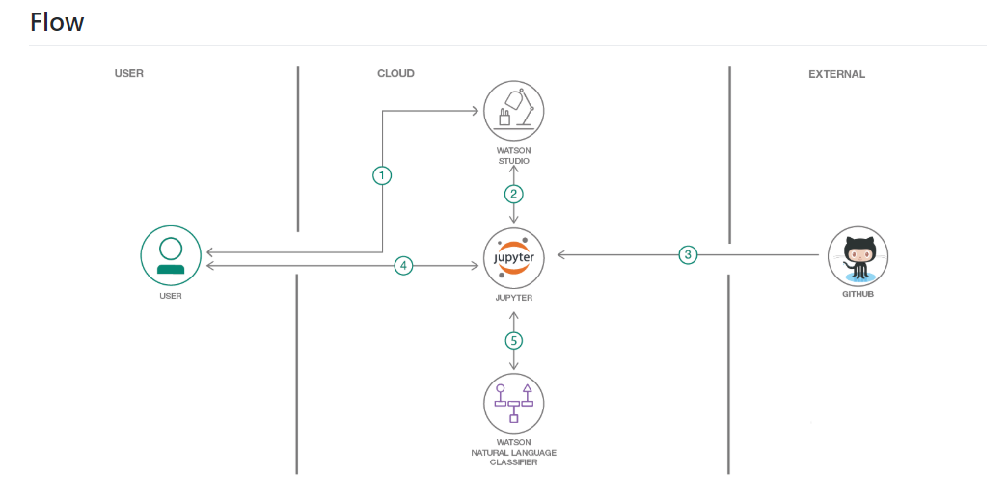

Slide 7
Creation of the project:
The developer creates an IBM Watson Studio Workspace
Using Watson Studio, the developer creates a Jupyter notebook and Watson NLC instance.
User can create a new dataset from Github, or use exsiting one in this repo.
User interacts with notebook to Build Naive Bayes Classifier and Natural Language Classifier instance using the Watson SDK.
The notebook Python code can use NLC apis to create and use a classifier.

Slide 8
Furture Scope:
Machine Translation.
Chatbots
Conversational Search
Outcome Prediction

Slide 9
conclusion
Watson Natural Language Classifier brings a sophisticated machine-learning classifier to IBM Cloud. Its approachable and intuitive REST interface makes it very easy for developers of all backgrounds to quickly train, test, and apply new classifiers to real-world problems.

Slide 10
THANK YOU

